Slide 1
Terry Long
Revitalization Strategist, BSCNC

Slide 2
After Assessing Approximately 1,200 NC Churches…

Slide 3
“9 out of 10 churches need some form of revitalization.”
Thom Rainer

Slide 4
Prognosis without diagnosis is malpractice.

Slide 5
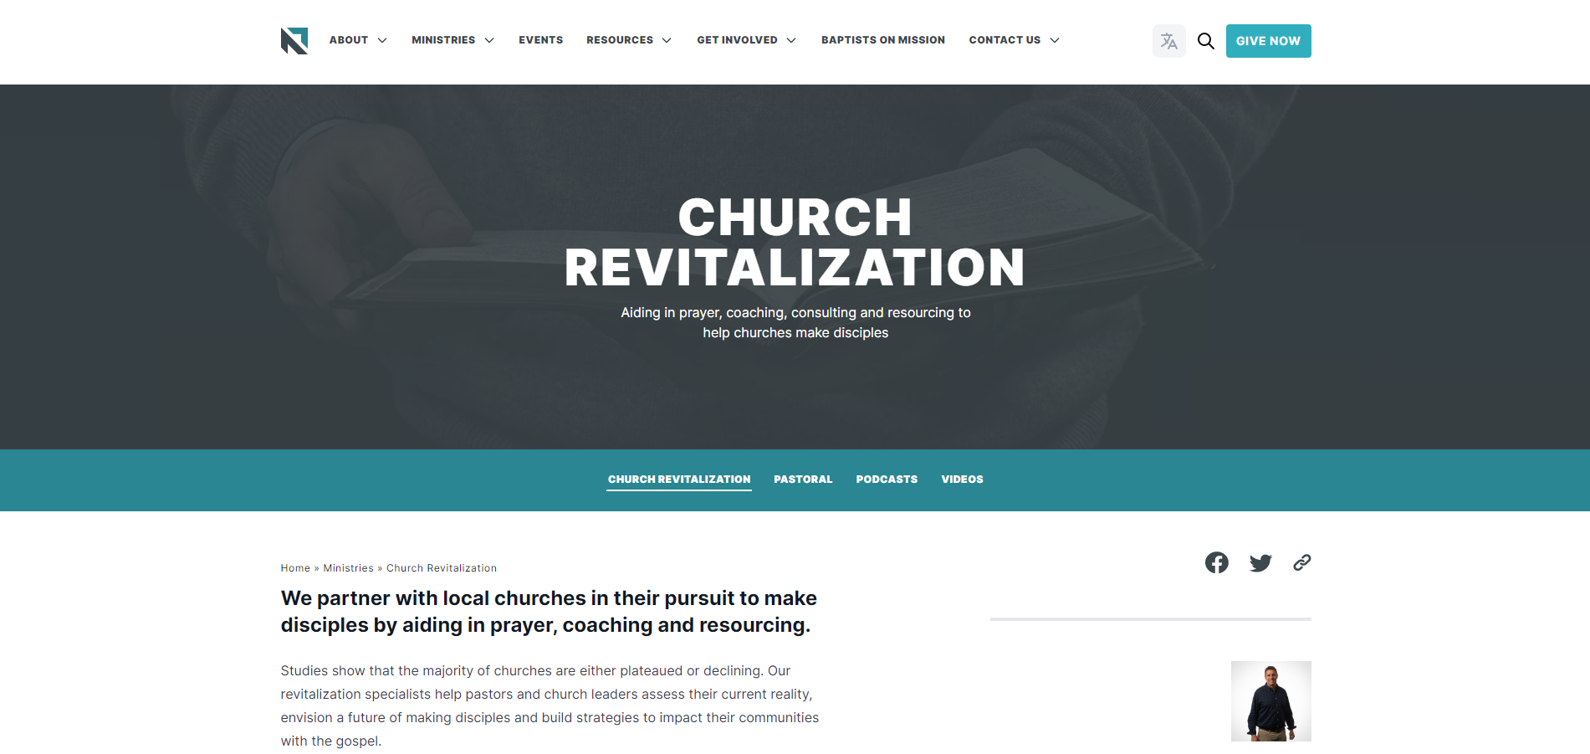
Initial Assessment
Take the assessment at ncbaptist.org/revitalize

Slide 6
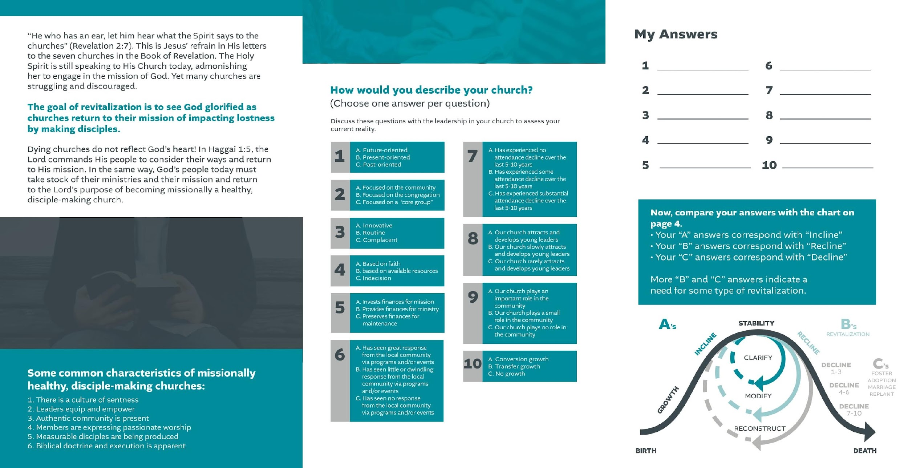
Initial Assessment
10 Questions designed to identify the church’s status on the church life cycle; Incline, Recline, or Decline.

Slide 7
Incline, Recline, Decline
Unfortunately, very few churches are actually in an incline. Some are in a slight decline and need to clarify their focus on outreach. Some are in a slow decline and need to modify. internal and external focuses. Some are in a substantial decline and need to reconstruct. We desire to have unique and specialized plans with tools for all of these churches.

Slide 8
Over 51% Need Reconstruction
..Revitalization...
..Fostering..........
..Adoption..........
..Marriage...........
..Replant.............
..Shared Space..

Slide 9
Over 51% Need Reconstruction
No response by the local community.
Substantial attendance decline over the last 5-10 years.
Rarely attract and develop
young leaders.

Slide 12
Biblical Basis
1 Corinthians 16:1–4 (ESV)
“Now concerning the collection for the saints: as I directed the churches of Galatia, so you also are to do. On the first day of every week, each of you is to put something aside and store it up, as he may prosper, so that there will be no collecting when I come. And when I arrive, I will send those whom you accredit by letter to carry your gift to Jerusalem. If it seems advisable that I should go also, they will accompany me.”

Slide 13
There Must Be Guidelines

Slide 15
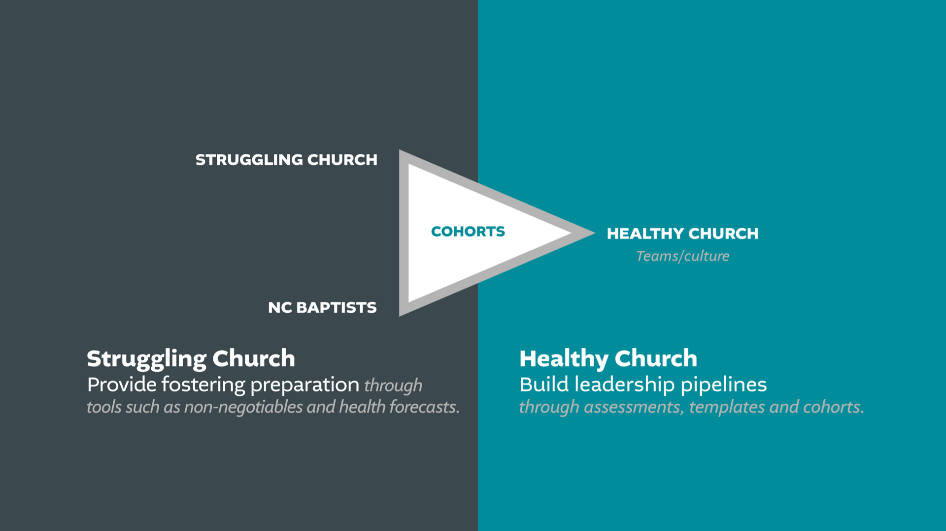

Slide 16
Best practices for the healthy church
Getting Started
Build your church leadership pipeline
Find a Foster by: Building a relationship with a pastor
Take the initiative (with the motive of caring for the pastor or church not for leverage)
One-on-one encouragement
Coaching
Cohorts

Slide 17
Best practices for the healthy church
Getting Started
Reach out to some pastors of struggling churches. Buy lunch or coffee. Build a relationship. If this becomes several connections, start a cohort.
Reach out to some pastors of struggling churches.
Host a one day fostering intensive.
Be involved in your association (not for gain).

Slide 18
Best practices for the
struggling church
Take an assessment (current).
Take the initiative (with a church, association, or network).
Be willing to receive help that is not on your own terms.
Change leadership (not necessarily a change in leadership).
Be willing to do things to serve and reach out to the community.

Slide 19
Best practices for the healthy church
How Do We Start?
Ask your team to serve no more but no less than a year (rotation of some for programming is helpful).
Who:
Planter/entrepreneur type.
Team around greatest needs.
From that area. Within driving distance.
Young families with preschool children.
Unshakeable saints.
Think like a missionary. (Learn context, resist attitude of superiority.)

Slide 20
Best practices for the healthy church
How Do We Start?
How long?:
3 months- bridge for healthy transition in a crisis.
6 months- if they need a strategy and some training.
1 year- providing a possible new context and leadership.
Have a Document of Understanding (DOU) with the expectations for both churches.
Start with the greatest needs (preaching, worship, and outreach).

Slide 21
Fostering to Revitalize
or Foster to Replant
To Revitalize: DOU’s have just bottom floor
To Replant: DOU includes 2nd period with top floor
Foster to Replant during Interim

Slide 22
Best practices for the healthy church
During Fostering
Have a quarterly update and clarification meeting. Does the partnership need to change on the micro or macro level?
Provide potential options after the commitment.

Slide 23
Best practices for the healthy church
How Do We End?
Final quarter, prepare for transition.
Have a celebration with both congregations.
If there is a realization that the relationship should continue because the struggling church will not make it on its own (after the year) adoption or Replant should be considered.

Slide 24
Best practices for the healthy church
Are We A Good Fit For A Replant?
Doctrine and Polity
Leadership
Community (to reach)
Facility Assessment
Bylaws and Governing Documents
Financial

Slide 25
Best practices for the healthy church
Other Tips and Thoughts
Send your teams out as missionaries (keep a network with and behind them).
Fostering grows your congregation’s missions force and mentality.
Keep your church update and encouraged.
Servant attitude not expecting anything in return (kingdom mindset).

Slide 26
Best practices for the healthy church
Other Tips and Thoughts
Be aware of the spiritual warfare.
“It is the churches that are striving for the gospel that the enemy comes after. But God intends it for good.” – Chuck Lawless
(Gen. 50:20; Rom. 8:29)

Slide 27
Best practices for the association, state convention and network:
Partner through prayer, assessments and fit.
Provide resources like example DOU’s, tips and training.
Guide the process until partnership has formed. Be the bridge.
Connect cohort churches in the area with others that are fostering.

Slide 29
Our Vision
“To have one Foster-Replant Team in every region of the state by 2024.”

Slide 30
Our Vision
For the Struggling/Legacy Church
Assessment
Consultation
Confirmation (AMS/BSCNC)

Slide 31
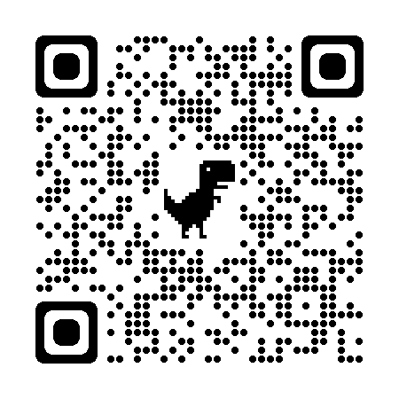
Next Steps for the Struggling Church
Scan the QR code to take the initial assessment to have a follow up consultation about your answers and what’s next for your church.

Slide 32
Our Vision
For the Sending Church
4 or more sending churches meet every 6-8 weeks
Sending Church Profiles
Lead / Partner (Context and Profile)

Slide 33
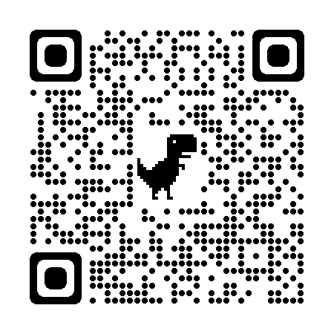
Next Steps for the Sending Church
Use the Sending Church QR code to sign up to be part of this
kingdom work in becoming a Fostering to Replant Partner.

Slide 34
ncbaptist.org/pastoral

